Slide 1
Geoscience WG update
PRAGMA 25
Whey-Fone Tsai
Yoshio Tanaka
Sarawut Ninsawat
Sornthep Vannarat

Slide 2
About Geoscience WG
Geographic data infrastructure and data sharing
Disaster mitigation
Environmental study
Current activities
Asia Geo Grid Initiative
Cloud based disaster management information platform
Flood and ocean modeling
Coral Reef Monitoring

Slide 3
Last Workshop
Presentations
Coastal/Flood simulation by NECTEC
VNU satellite data infrastructure
Asia Geo Grid Initiative by AIST
VAST tsunami simulation
Discussions: Guideline for Geoscience application development
To facilitate common tools and standard APIs
Specify e.g. architecture, data handling, processing, visualization
How to come up with guideline: analyzing existing applications, phone discussion

Slide 4
Coastal Ocean Simulation
Deeper understanding of storm surge simulation results also continues
Possibility of stronger
storm surge due to CC

Slide 5
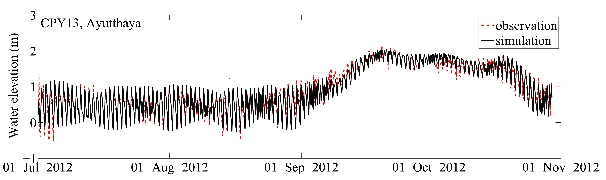
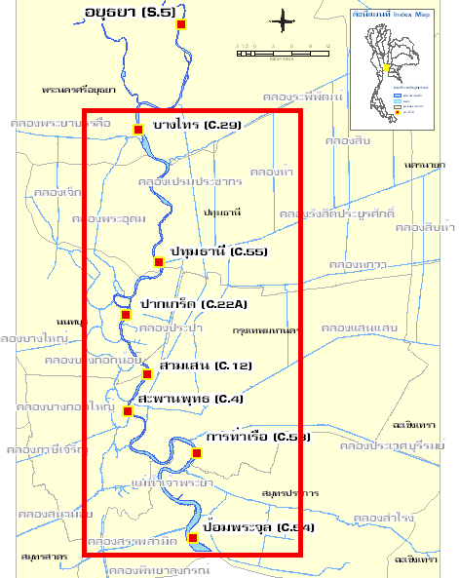
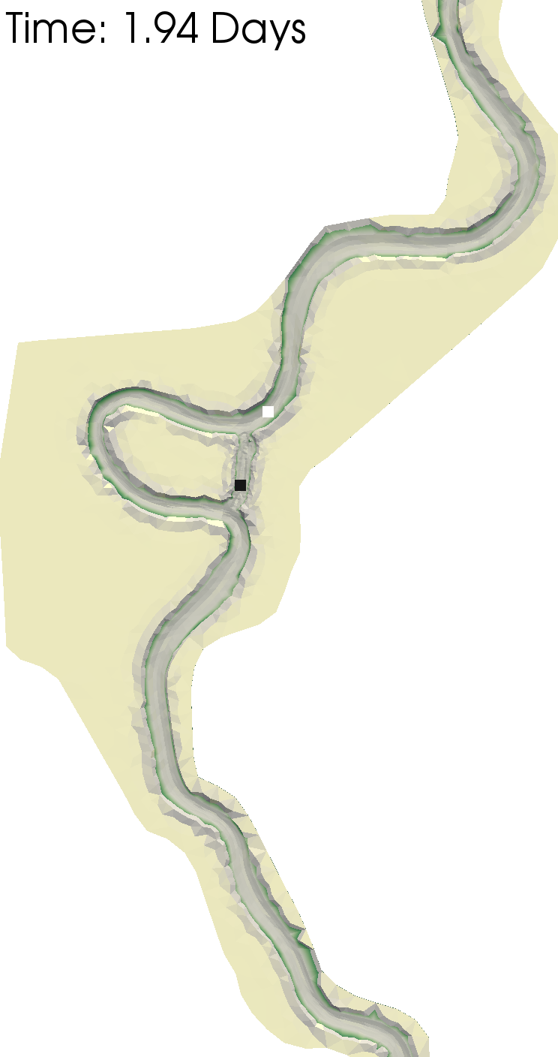
Flood modeling
Tide and river interaction

Slide 6
NCHC/NARL Disaster Management Information Platform update
Collaboration plan meetings between NECTEC & NCHC for “Cyberinfrastructure development for reservoir operation and flood forecast”. NECTEC visited NCHC March 13-15; NCHC visited NECTEC March 20. Technology collaboration items may include:
Digital watershed
Sensor network
3D GIS application system
River forecast models

Slide 7
NCHC/NARL Disaster Management Information Platform update
NECTEC researchers, Pished Bunnun, Rangsarit Vanijjirattikhan, and Udom Lewlomphaisarl visited NCHC between May and June for collaboration and exchange ideas in areas of 3D GIS, flood modeling, and sensor network associated with disaster management.
NCHC, in collaboration with universities and IT companies in Taiwan, has planned a Hadoop-like file system for global climate model simulation and big data analytics.

Slide 8
NCHC’s Disaster Management Information Platform has been adopted to support Taiwan industrial association for disaster prevention, and Taiwan Climate Change Information Program.

Slide 9
Solar Energy Map Generator
Potential of solar energy production needed for renewable energy policy
Existing work on solar energy maps
Our aim is map generator – combining data e.g. solar intensity, land slope, land use, population density, electricity infrastructure availability, weather data (cloud, rain, temperature, wind), solar technology specific data (e.g. roof area for roof-top solar panels)

Slide 10
Asia GEO Grid
Started a new project on DB federation framework for radiation monitoring.

Slide 11
Coral Reef Monitoring
Attended the tutorial work shop on Sensor Pod in TFRI, Taiwan
Discussed developing user and developer community
Trying out Sensor Pod at Racha Island

